Slide 1
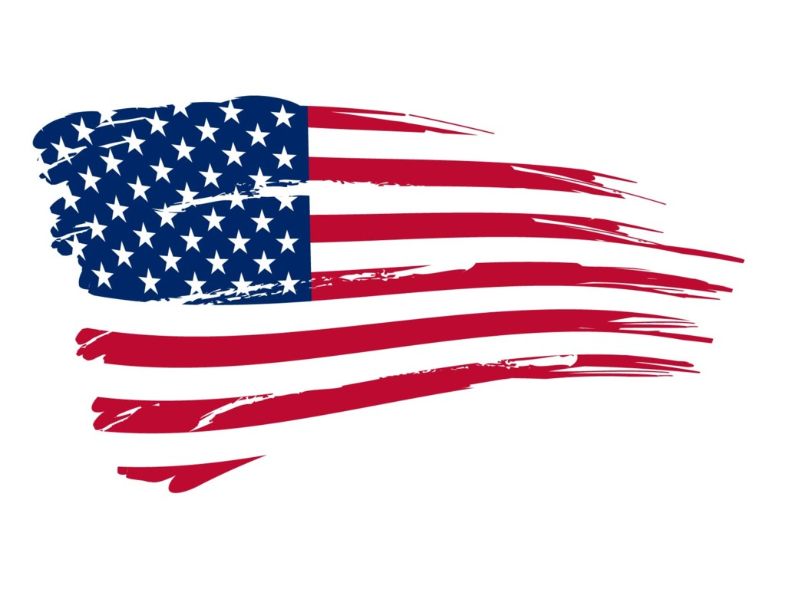
An Introduction to the American Legal System
Why study law & ethics in media?

Slide 2
Law and American Society
Civil rights
Constraints—on whom?
Why is law relevant to the field?
The concept of “freedom”

Slide 3
Ethics and American Society
Civic responsibilities
How are ethics developed?
Relevance to the field?
The concept of “responsibility” (to whom and why?)

Slide 4
Why study Law and Ethics?
Journalism is a field based on public service
In serving the interests of others, knowing the limits and ramifications of our actions is essential
Journalism evolved from the democratic design of self-governance and serves as the role of “watchdog”
As Americans (not even journalists), we have a responsibility as members of a democratic society to be informed and aware of legal and ethical issues to make informed choices

Slide 5
Law and ethics = freedom + responsibility
How values and social context inform decision-making
Navigating fuzzy lines
Limits of language
Can we be both responsible and free?

Slide 6
Basic organizing principle of democracy: Federalism
Constitutional division between central governing body for all and constituent groups (i.e. federal government shares governance with states)
Also, representative government—we elect people who represent our ideas about how we wish to be governed

Slide 7
How some Founding Fathers divided
Federalists
Alexander Hamilton
George Washington
James Madison
John Adams
Confederalists
(Anti-Federalists)
Thomas Paine
Samuel Adams
Patrick Henry
John Hancock

Slide 8
Some terms
Confederates-- (confederalism) seek individual rule by states, smaller governing bodies.
Federalists (federalism) seek larger dominant governance of central governing body (the federal government) with the state governance secondary in power.

Slide 9
Three key documents

Slide 10
If we’re going to be independent…
Declaration of Independence explained the Colonies’ need to be free of British rule
U.S. Constitution set up the American government structure
Bill of Rights defined individual civil rights

Slide 11
Declaration of Independence
Thomas Jefferson, primary author
Adopted by Continental Congress July 4, 1776
Formally declared independence from British rule
Transformed the thirteen British Colonies into the United States of America
Revolutionary War lasts from 1775-1783.

Slide 12
U.S. Constitution
Replaced the Articles of Confederation (the first Constitution)
War had been concluded for four years
Many problems with states acting independently

Slide 13
U.S. Constitution
States were out of money, not paying taxes
Because states could not defend themselves without money, national defense was at risk
Money needed to be managed at the federal level—not at the state

Slide 14
U.S. Constitution
Document outlined federal and state government responsibilities
Is supreme law of the land
Written September 1787; ratified by the states
Went into effect in March 1789

Slide 15
Bill of Rights
The U.S. Constitution outlined government roles in a preamble and seven original articles
Founding Fathers argued that there needed to be amendments to protect individual civil rights
Amendment = change or addition

Slide 16
Bill of Rights
First ten (10) amendments to the Constitution
Written in September 1789; ratified in December 1791
Primary author: James Madison

Slide 17
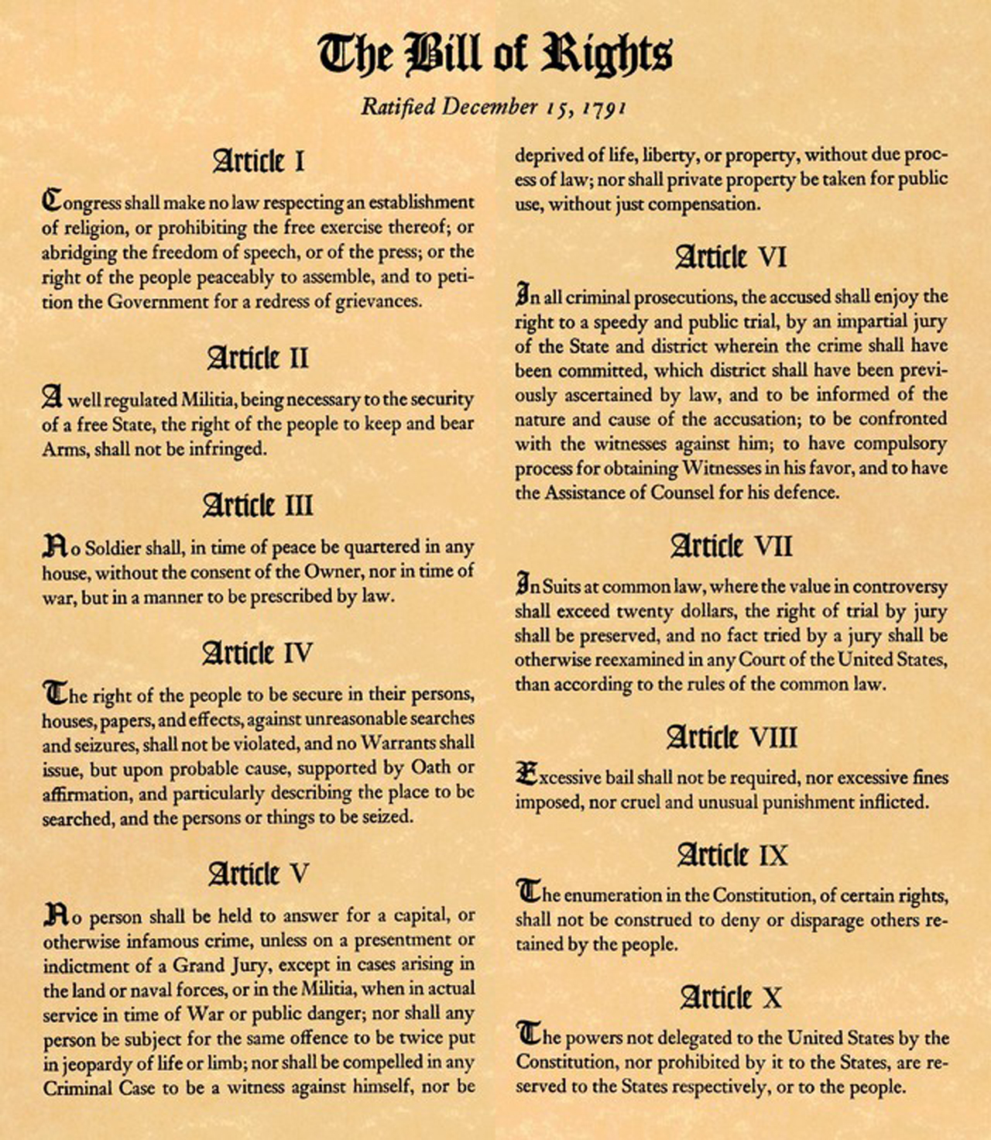

Slide 18
Government structure & legal system
U.S. Constitution outlines government structure
Judicial Branch limits and reach are outlined there

Slide 19
Legal structure
Criminal and civil courts
Different levels of courts—
Local trial courts/magistrates
State trial courts
Appellate courts (state, state Supreme Courts, U.S. District, U.S. Circuit Court of Appeals)
U.S. Supreme Court

Slide 20
The trial justice process

Slide 21
Why we focus on appellate decisions
Trial verdicts, while often splashy and interesting, don’t tend to cast a wide net in terms of altering the way we see a specific issue. Each trial verdict tends to be unique to circumstances.
Appellate court decisions are often about the interpretation of existing law; thus, they can have far-reaching implications and can definitely change how we see a specific issue.

Slide 22
Types of law
Civil Law--private law, the law under which harmed individuals or companies can sue other individuals or companies in order to extract some sort of money or legal remedy (ex. Divorce, child custody, copyright infringement and libel)
Criminal Law--the government prosecutes accused individuals on behalf of the public for the commission of a crime (ex. Murder, kidnapping, or rape).

Slide 23
Types of law cont’d.
Constitutional Law--This type of law comes from a charter established by the government to govern the people (both Federal and State). Highest form of law.
Statutory Law—just below Constitutional law in importance—based on state constitutions

Slide 24
Types of law cont’d.
Administrative Law—law created by administrative entities in the forms of rules, regulations, orders, etc. (ex. Federal Communication Commission)
Case Law (aka Common Law)--refers to the binding principles and rules that originate from case-by-case judicial decisions. The cases help judges interpret law.

Slide 25
Terms
Per curiam—Latin for ‘by the Court’. Often used to reference a decision written by a presiding judge. Can refer to a unanimous decision or an opinion delivered without naming an author.
Writ of Certiorari—A decision by the Supreme Court to hear an appeal from a lower court.

Slide 26
More terms
Appellant—the person/persons who is appealing to a higher court (this is usually the party who lost at the prior level of court)
Respondent—the person/persons on the other side of the case

Slide 27
More terms
Jurisdiction--basically asks who has the authority to make and enforce the law? This implies rights, powers, and limits. Should the ruling reside at the local, state or national (federal) level?
Precedent--Under the doctrine of precedent a prior judicial decision serves as a governing model for future cases arising under identical or similar facts.

Slide 28
U.S. Circuit Court of Appeals

Slide 29
U.S. Supreme Court
The only court specifically established by the U.S. Constitution (it grants Congress the power to create ‘inferior courts’)
Final arbiter of the U.S. Constitution
Nine members of the Court—nominated by President, confirmed by Congress

Slide 30
Types of Court opinions
Majority—ruling opinion; rationale for the ruling (usually authored by one Justice)
Concurring opinion—agrees with majority but wants to emphasize different rationale (can be multiple concurrences)
Dissent—judges who disagree with the ruling on one point or another may write a dissent

Slide 32
Ethics: system of moral principles that guide behavior/decisions
Concern for Self
Concern for Other
Concern for all—(i.e.,“society”)

Slide 33
Libertarianism + Communitarianism
Libertarian ethics: driven by individual concern; amoral (inasmuch as decisions are made situationally and not on universalist moral judgment); seeks liberation and autonomy; emphasizes particularism
Communitarian ethics: driven by community or collective concern; utilizes socially agreed-upon moral virtues; emphasizes advancement of collective

Slide 34
Kohlberg on moral development
Pre-conventional: 1. obedience and punishment avoidance; 2. self interest
Conventional: 3. interpersonal accord/conformity; 4. law and order morality;
Post-conventional: 5. Social contract (value differing viewpoints); 6. Universal ethical principles/principled conscience

Slide 35
Why we study both law and ethics
Making decisions
What those decisions say about us
How those decisions impact others
Law and ethics work hand in hand on that front

Slide 36
Case Study: Edward Snowden
Ethics versus law
PATRIOT ACT
Fourth Amendment (‘The right of the people to be secure in their persons, houses, papers, and effects, against unreasonable searches and seizures)
First Amendment
What would you do?

Slide 37
Some key First Amendment sites
www.firstamendmentcenter.org/
www.splc.org/
www.oyez.org/cases
www.law.cornell.edu

