Slide 1
Symbolic Speech & Offending the Masses
Content-based protections

Slide 2
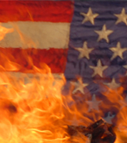
History of flag burning issue
Halter v. Nebraska (1907)—SCOTUS upheld the idea that flag desecration could be prohibited (can’t sell beer with flags on the labels)
1968—Congress passes Federal Flag Desecration Law
1972—SCOTUS ruled that laws banning the “contempt” of the flag were overbroad/vague (Smith. V. Goguen)
1974—SCOTUS rules in Spence v. Washington that affixing peace sign stickers to flag constitutionally protected speech

Slide 3
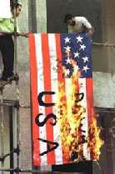
1968 Federal Flag Desecration Act
In response to anti-war protests (Vietnam) that involved flag burning
(a)(1) “Whoever knowingly mutilates, defaces, physically defiles, burns, maintains on the floor or ground, or tramples upon any flag of the United States shall be fined under this title or imprisoned for not more than one year, or both.”

Slide 4
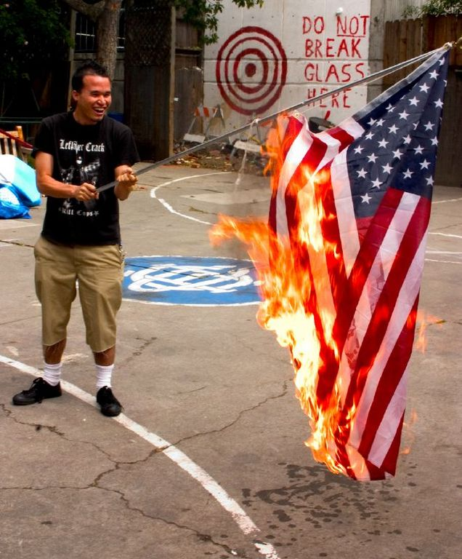
Texas v. Johnson (1989)

Slide 5
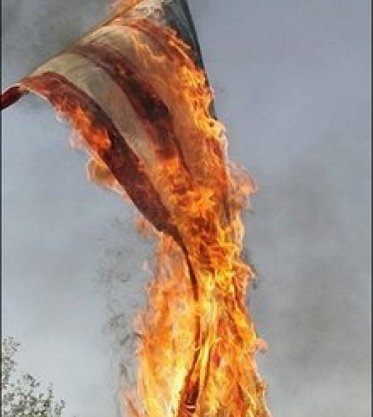
What’s at issue?
Gregory Johnson—member of the Revolutionary Communist Youth Brigade
Protesting the 1984 RNC in Dallas, Texas
Texas law criminalized vandalizing venerated objects (48 states had similar laws)

Slide 6
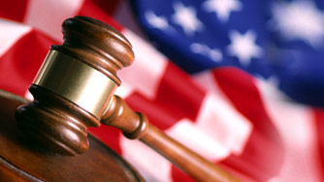
Why is desecrating the flag so offensive?
Nationalism/patriotism
Post-Vietnam sentiment that certain forms of protest are potentially dangerous
Walking fine line between 1A freedom and prevention of violence

Slide 7
Non-Friday Trivia Question
How many times has U.S. Congress attempted to introduce a Constitutional amendment to ban flag burning since Texas v. Johnson ruling?

Slide 8
Non-Friday Trivia Question
How many times has U.S. Congress attempted to introduce a Constitutional amendment to ban flag burning since Texas v. Johnson ruling?
Answer: Seven! 1990, 1995, 1997, 1999-2000, 2001, 2003, 2005-2006. Since 1995 has consistently pass the House, but failed in Senate

Slide 9
Texas v. Johnson 1989 ruling
Majority: Brennan, Marshall, Blackmun, Scalia, Kennedy
Concurrence: Kennedy
Dissent: Rehnquist, White, O’Connor, Stevens

Slide 10
Study Guide for Test #1
Test format: Definition, short answer, multiple choice, essay
Cases for review:
Minersville v. Gobitis
W. Virginia v. Barnette
Near v. Minnesota
New York Times v. US
R.A.V. v. St. Paul
Brandenburg v. Ohio
Chaplinsky v. New Hampshire
Texas v. Johnson

Slide 11
Test Study Guide cont’d.
Chapters 1-3
Focus on key outcomes of cases, dates, rulings
Review slides from lectures
Make a vocabulary list (using key terms in text)

