Slide 1
Congress shall make no law
…Respecting an establishment of religion, or prohibiting the free exercise thereof

Slide 2
Congress shall make no law…
Respecting an establishment of religion, or
prohibiting the free exercise thereof

Slide 3
The Establishment Clause
Congress shall make no law respecting an establishment of religion…
Government mandated, sanctioned faith

Slide 4
Jefferson & Madison: ‘Keep ‘em separate!’
Reaction to the Church of England
Jefferson believed in the secularity of government
Immigration to America spurred in part by desire to worship independent of government interference

Slide 5
Abuses and Issues
Public School issues
Public prayer issues
Public art/monuments on government grounds

Slide 6
Limits to 1A Application
“Congress shall make no law…”
Legal reach limited to public entities
Private schools not covered

Slide 7
Ethics: system of moral principles
Concern for Self
Concern for Other
Concern for all—(i.e.,“society”)

Slide 8
Libertarianism + Communitarianism
Libertarian ethics: driven by individual concern; amoral (inasmuch as decisions are made situationally and not on universalist moral judgment); seeks liberation and autonomy; emphasizes particularism
Communitarian ethics: driven by community or collective concern; utilizes socially agreed-upon moral virtues; emphasizes advancement of collective

Slide 9
Kohlberg on moral development
Pre-conventional: 1. obedience and punishment avoidance; 2. self interest
Conventional: 3. interpersonal accord/conformity; 4. law and order morality;
Post-conventional: 5. Social contract (value differing viewpoints); 6. Universal ethical principles/principled conscience

Slide 10
Why we study both law and ethics
Making decisions
What those decisions say about us
How those decisions impact others
Law and ethics work hand in hand on that front

Slide 11
Case Study: Edward Snowden
Ethics versus law
PATRIOT ACT
Fourth Amendment (‘The right of the people to be secure in their persons, houses, papers, and effects, against unreasonable searches and seizures)
First Amendment
What would you do?

Slide 12
Some key First Amendment sites
www.firstamendmentcenter.org/
www.splc.org/
www.oyez.org/cases
www.law.cornell.edu

Slide 13
Saluting the Flag

Slide 14
Infringement of civil rights
Minersville, PA—90% Roman Catholic
Claimants: Walter Gobitas; children Lillian (12) & Billy (10) (Jehovah’s witness)
Argued that to “worship” or idolize “worldly things” or “graven images” was an affront to religious beliefs.

Slide 15
Minersville School District v. Gobitis (1940)
Some animosity toward Jehovah’s Witnesses—1935 objection to compelled speech. Carleton Nichols (third grader in Mass.)
The year is 1938—concern for what is going on in the world; unity and nationalism becomes pressing by the time 1940 Supreme Court ruling happens.
National unity is the basis of national security

Slide 16
At Issue

Slide 17
At Issue
From the School District
Desire to control what occurs in classroom
Nationalist movement due to world events
Dominant suspicion of Jehovah’s Witnesses
For Jehovah’s Witnesses
Compelled speech violates religious tenets
Is non-participation considered “free speech?”
Action is in response at least in part to wider public abuses.

Slide 18
The ruling
Supreme Court ruling 8-1 in favor of Minersville School District.
Court declined to make itself the “school board for the country”
Lone Dissent: Justice Harlan Stone

Slide 19
Excerpts of arguments
Majority Opinion (written by Felix Frankfurter):
“National unity is the basis of national security. To deny the legislature the right to select appropriate means for its attainment presents a totally different order of problem from that of the propriety of subordinating the possible ugliness of littered streets to the free expression opinion through handbills.”

Slide 20
Excerpts of arguments
Dissenting Opinion (Justice Harlan Stone):
“The guarantees of civil liberty are but guarantees of freedom of the human mind and spirit and of reasonable freedom and opportunity to express them...The very essence of the liberty which they guarantee is the freedom of the individual from compulsion as to what he shall think and what he shall say...”

Slide 21
Fallout from ruling
Nationwide backlash against Jehovah’s Witnesses who were seen as “un-American.”
From Maine to Texas, Jehovah’s Witnesses are jailed, beaten, harassed.
Court ruling viewed as blank check of government disapproval of religious beliefs

Slide 22
West Virginia Board of Education v. Barnette (1943)
Three years after Minersville ruling. What’s happened in the nation/world at this point?

Slide 23
West Virginia Board of Ed. v. Barnette (1943)
1940-1943
Pearl Harbor attacked; US entered the war, learned yet more about Hitler’s control
Nationalism remains stronger than ever
But…fear of government control was a competing issue

Slide 24
How the Court changed
Minersville School Dist.
v. Gobitis (1940)
Chief Justice Charles E. Hughes
Associate Justices James C. McReynolds; Harlan F. Stone ; Owen J. Roberts; Hugo Black ; Stanley F. Reed; Felix Frankfurter ; William O. Douglas; Frank Murphy
W. Virginia Board of Ed.
v. Barnette (1943)
Chief Justice Harlan F. Stone
Associate Justices Owen J. Roberts; Hugo Black; Stanley F. Reed ; Felix Frankfurter; William O. Douglas ; Frank Murphy Robert H. Jackson ; Wiley B. Rutledge

Slide 25
W. Virginia Board of Ed. v. Barnette
Recall national reaction to Gobitis ruling.
West Virginia Board of Education mandated courses in civics, history, and the Constitution to “perpetuate the ideals , principles, and spirit of Americanism.”
All teachers and pupils required to participate in the Pledge of Allegiance

Slide 26
W. Virginia Board of Ed. v. Barnette
Failure to comply was considered ‘insubordination’ which would require punishment
Barnettes were Jehovah’s Witnesses who challenged the state mandate on grounds that it violated free speech

Slide 27
W. Virginia v. Barnette (1943) Ruling
Court held 6-3—that the free speech clause of the First Amendment prohibited public schools from compelling students to salute the flag and say the Pledge of Allegiance.
Reversed Minersville v. Gobitis (1940) precedent

Slide 28
Why the change?
The Court had changed. Two new justices
Stone (lone dissenter in Gobitis) was now Chief Justice
Focus changed—less an issue of free religion than free speech

Slide 29
Justice Robert Jackson wrote Majority Decision
“Those who begin coercive elimination of dissent soon find themselves exterminating dissenters. Compulsory unification of opinion achieves only the unanimity of the graveyard.”
–Justice Robert Jackson in Majority Decision for West Virginia Board of Education v. Barnette (1943)

Slide 30
Justice Felix Frankfurter Wrote Dissent
“Flooded with letters” following Gobitis ruling.
Frankfurter stuck with the freedom of religion concept in his dissent, though it was freedom of speech that underpinned the majority ruling.
“The constitutional protection of religious freedom terminated disabilities, it did not create new privileges. It gave religious equality, not civil immunity. Its essence is freedom from conformity to religious dogma, not freedom from conformity to law because of religious dogma.” —F. Frankfurter, dissent

Slide 31
Deontological v. Consequentialist Ethics
Deontological
Duty-based ethics; how closely does the action adhere to a socially agreed-upon rule or law?
Behavior itself has inherent “rightness” or “wrongness”
Moral absolutism: Killing is always bad
Consequentialist
Consequences of action drive decision-making
The action or behavior itself is neither good nor bad; morally right nor wrong. Outcomes reflect moral value.
Ends justify the means: If killing Hitler ensures an earlier end to Holocaust, murder is ethical.

Slide 32
Ethics & the Church-State Wall
How might Deontologists see the Church and State question?

Slide 33
Consequentialist ethics
How would consequentialist ethicists see the separation of church & state issue?

Slide 34
Charlie Hebdo, Religion, Speech, & Ethics
French weekly, satirical magazine
Self-described atheist/secular
Well-known to poke fun at everyone
Target of terrorist attack in 2011 (firebombed)
‘Overt provocation’

Slide 35
1.7.15 Attack in Paris
Gunmen attacked Charlie Hebdo offices, killing 12 cartoonists, editors, and police
Shouted in Arabic, ‘God is Great!’
Manhunt for shooters ended in brief stand-off and eventually their deaths.

Slide 36
Free Speech? Freedom to Offend?

Slide 37
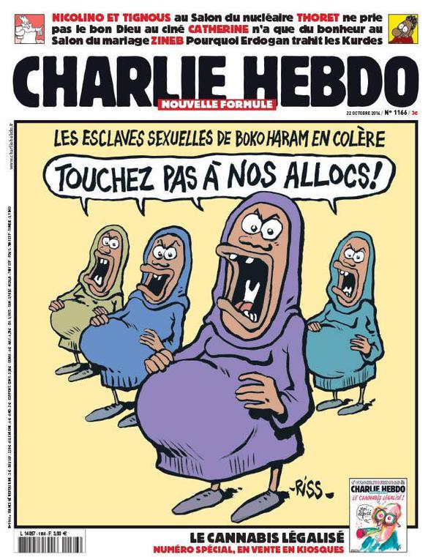

Slide 38
Ethical Implications of Satire
Given that the Rwandan genocide happened as a direct result of propaganda distributed via media, could this cause more violence?

Slide 39
The Cost of Freedom

Slide 40
State of the First Amendment Survey
Survey conducted by the First Amendment Center in partnership with the Newseum Institute
The survey has been conducted 17 times
National sample of 1,006 Americans

Slide 42
Of interest

Slide 43
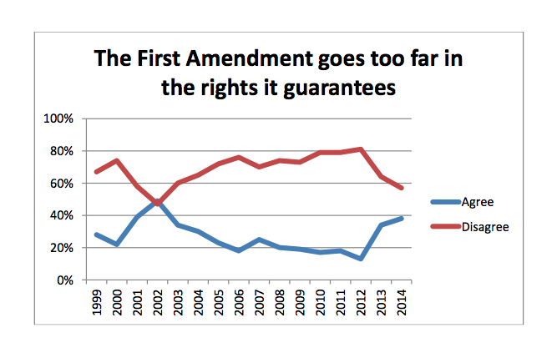

Slide 44
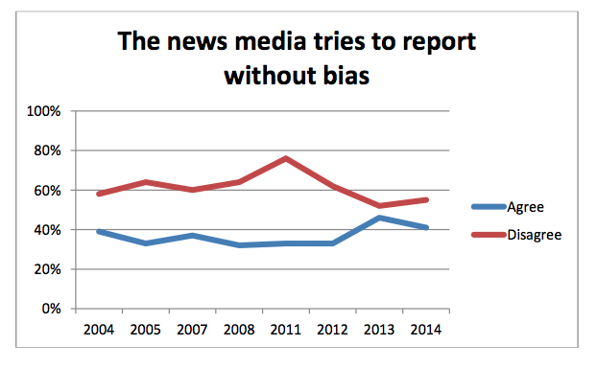

Slide 45
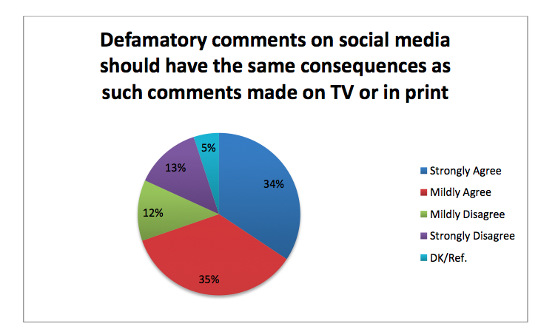

Slide 46
