Slide 1
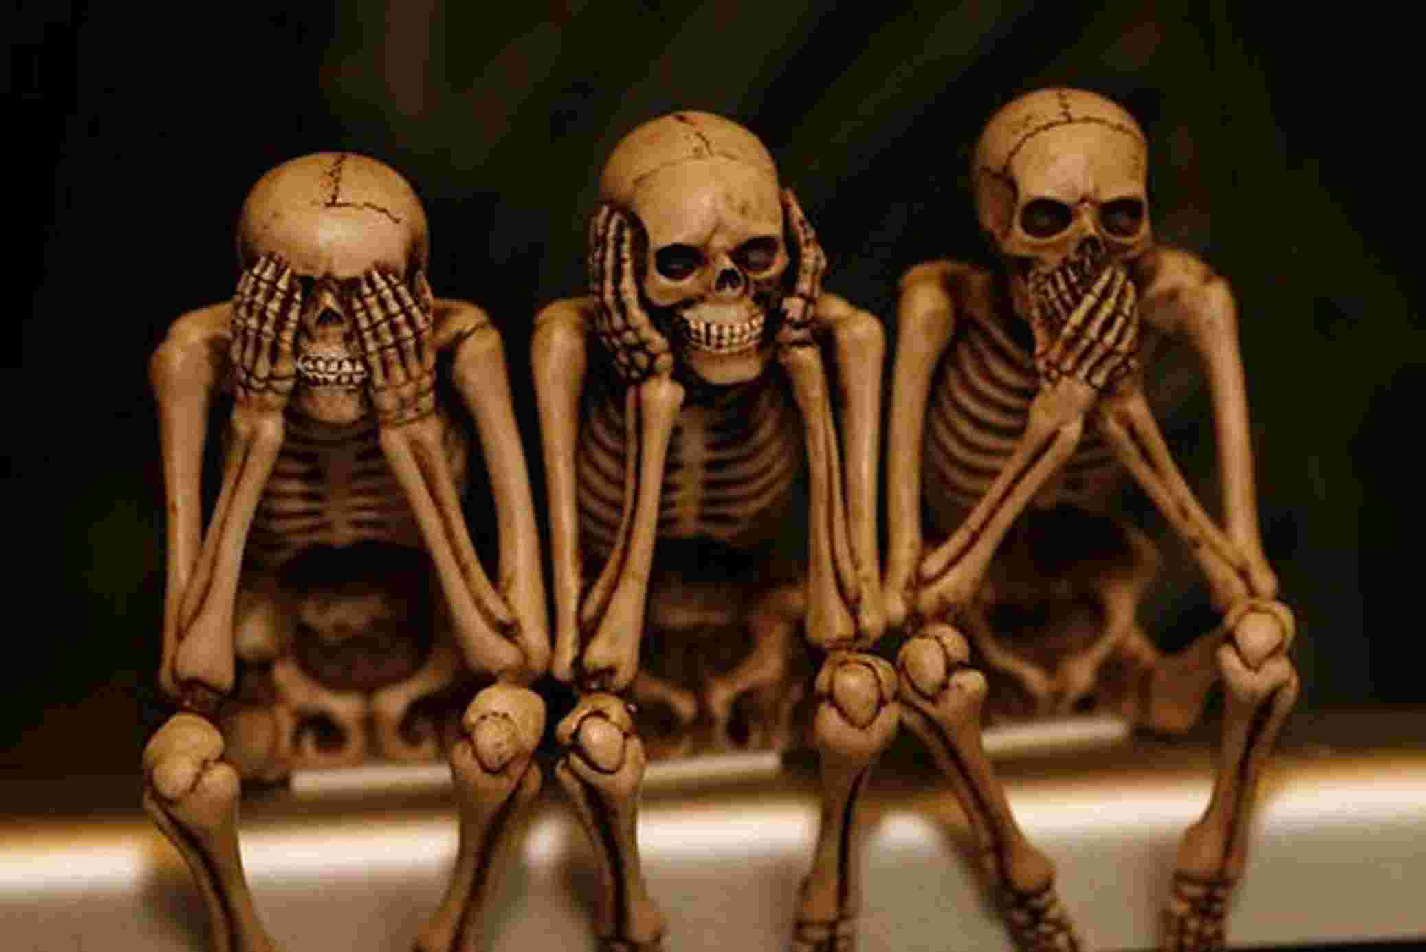
See No Evil; Hear No Evil; Speak No Evil
Obscenity and the First Amendment

Slide 2
Do we know it when we see it?
Obscenity
Indecency
Pornography
What’s the difference and should it matter?

Slide 3
Law v. ethics
The law has sought to define the boundaries. Are there things that should be banned at least to certain audiences? Yes, according to the courts.
Ethically, the question becomes just because we can say or create something, should we?
Historically, pockets of American audiences have been more conservative ethically than the law.

Slide 4
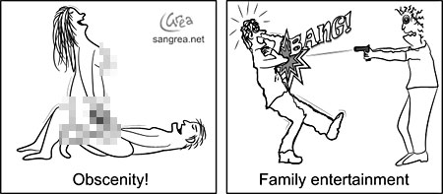

Slide 5
What informs our understanding of “obscenity”
Cultural values—who is the audience and how may they be impacted by the message?
Context—how and when is the message publicly delivered?
Richard Gere’s“obscene” gesture on national television—Indian culture clash

Slide 6
The Hicklin test (1868) & the Anti-Obscenity Act (1873)
Hicklin: The test of obscenity is whether the tendency of the matter as obscenity is to deprave and corrupt those whose minds are open to such immoral influences and into whose hands a publication…may fall.
Comstock: banned any “obscene, lewd, lascivious, or filthy book, pamphlet, picture, paper, letter, writing, print, or other publication of indecent character”

Slide 7
Problems with both
So restrictive that any piece of literature that merely offered passages that alluded to sex were banned.
How to judge “whose minds are open” to corruption?
How to judge intent?
How to judge ill-defined terms such as immorality and indecency?

Slide 8
A new era: Roth v. US (1957)
Samuel Roth—convicted of possessing and mailing erotic materials considered “obscene.”
Court upheld conviction, finding that he did violate California law.
The difference is that in majority decision, Justice William Brennan sought to define obscenity.
A work is obscene IF:
“[according to] the average person, applying contemporary community standards, the dominant theme of the material taken as a whole appeals to prurient interest.”

Slide 9
Jacobellis v. Ohio (1964)
Nico Jacobellis, a theater manager, convicted of violating Ohio law by screening an alleged obscene French film Les Amants (The Lovers).
Court overturned his conviction, ruling that the film was not obscene.
Indicated a loosening of court definition of what might be considered “patently offensive” and nudity alone could not constitute obscenity.

Slide 10
Potter Stewart’s famous ruling
Stewart wrote in his famous concurrence that while it was difficult to fully define ‘hard core pornography,’ “I know it when I see it…and the motion picture in this case was not that.”

Slide 11
Miller v. California 1973
Marvin Miller, owned mail order business specializing in erotica
Accused of violating California law that prohibited the sale and distribution of ‘obscene material’
Court held 5-4 in favor of California
Sought to further define “obscenity”

Slide 12
The Miller Test (1973)
An average person, applying contemporary community standards, would find that the work, taken as a whole, appeals to the prurient interest;
The work depicts or describes, in a patently offensive way, sexual conduct, and the applicable state law specifically defines what depictions or descriptions are prohibited; and
The work, taken as a whole, lacks serious literary, artistic, political or scientific value

Slide 13
How do we determine“serious literary, artistic, political or scientific value?”
Is it enough to offend a lot of folks, or can that be the political/artistic point?
Robert Mapplethorpe—highly acclaimed black and white photographer. Subject matter included a lot of homosexual eroticism and what many considered child pornography

Slide 14
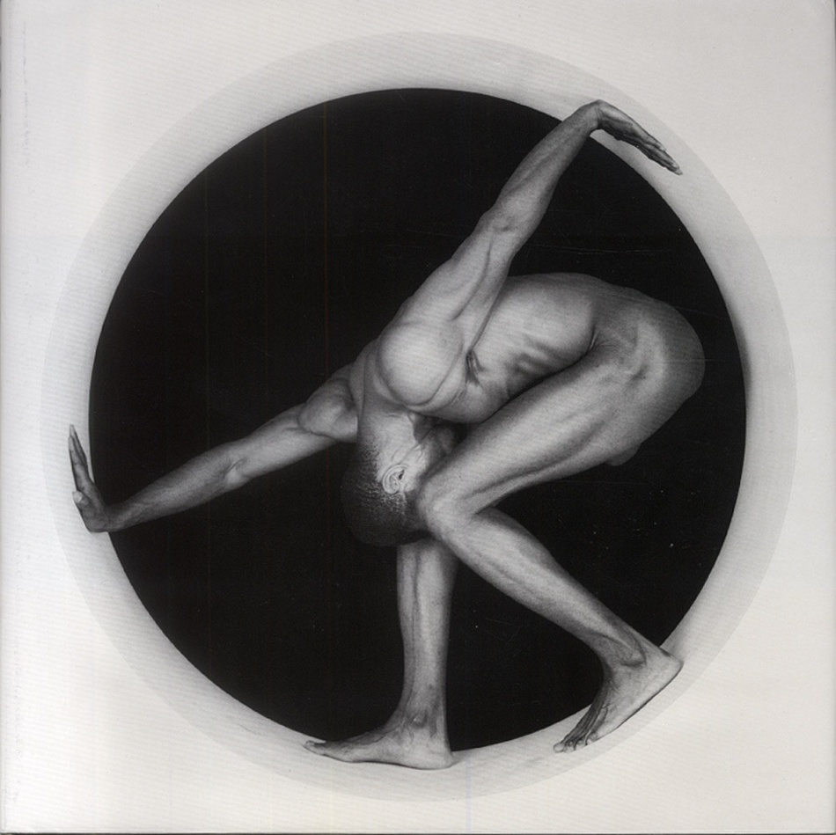

Slide 16
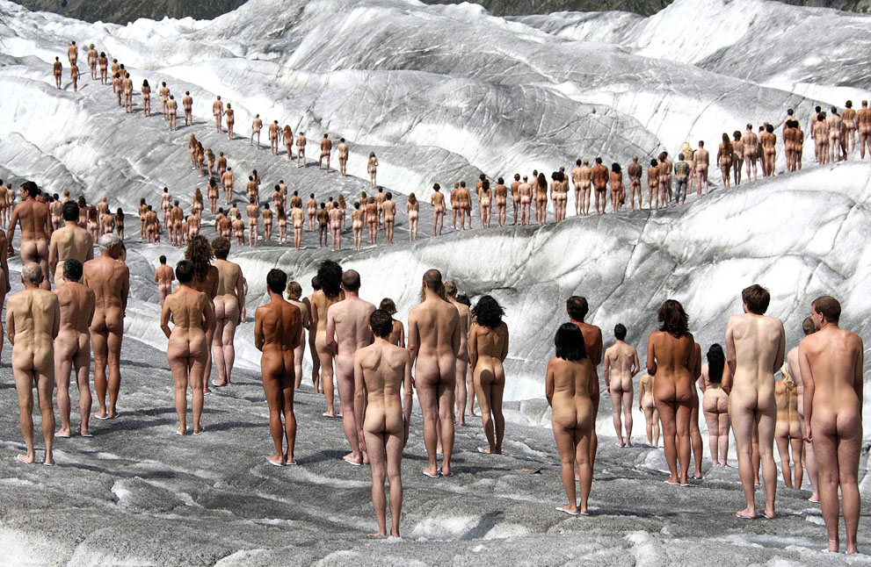

Slide 17
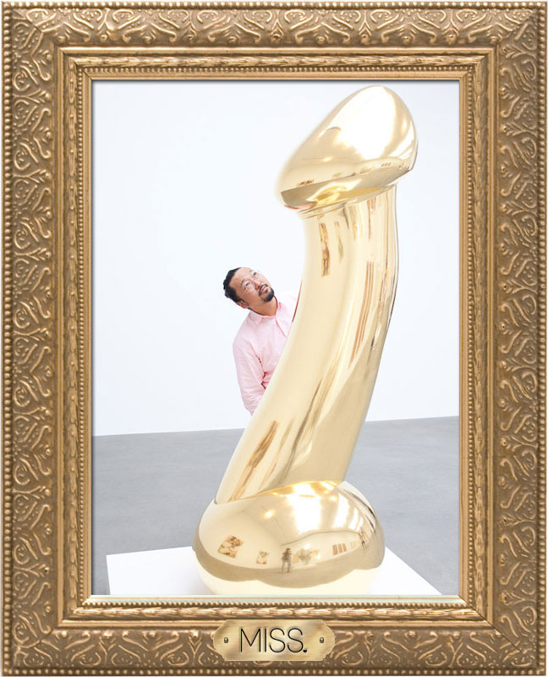

Slide 19
Public tolerance for artistic risk taking
Has the Internet changed public standards?
Other forms of technology (i.e. “sexting” Is it child pornography?)
Legal v. ethical: even if it’s legal, should it be available to all?

Slide 20
Current trend: protect children from exposure and exploitation
Zoning and decency laws aim to keep adult business out of main line of traffic for children
Internet locks on pornographic sites for under age users
Public nuisance laws shut down businesses that can be proven to attract crime

Slide 21
Barnes v. Glen Theatre 1991
What is government’s responsibility for protecting the morality of society?
South Bend, IN—two businesses specializing in erotica (Glen Theatre & Kitty Kat Lounge)
Statute called for dancers to be covered with at least a g-string or pasties
Both sought to change law

Slide 22
Is nudity obscene?
Plaintiffs claimed that the ban on total nudity was constitutionally overbroad
Supreme Court ruled 5-4 in favor of the state, acknowledging that while dancing could be considered a form of protected speech, the statute furthered substantial government interest in maintaining decency standards.

Slide 23
The ruling
"The requirement that the dancers don pasties and a G-string does not deprive the dance of whatever erotic message it conveys; it simply makes the message slightly less graphic. The perceived evil that Indiana seeks to address is not erotic dancing, but public nudity. The appearance of people of all shapes, sizes and ages in the nude at a beach, for example, would convey little if any erotic message, yet the state still seeks to prevent it. Public nudity is the evil the state seeks to prevent, whether or not it is combined with expressive activity.”
—Majority Decision Barnes v. Glen Theatre 1991

Slide 24
Can we? v. Should we?
Civil discourse
Public education
Advancing society
Utilitarian question:
Does a ‘win’ in court loosening obscenity standards using the 1A advance the collective greater good?

Slide 25
Issues in an electronic age
Child pornography—What about sexually explicit videos starring an actor who claimed to be an adult at the time of the shoot, but lied and was underage?
1977 Protection of Children Against Sexual Exploitation Act
1996 Child Pornography Prevention Act
2003 PROTECT

