Slide 1
One last note on Obscenity

Slide 2
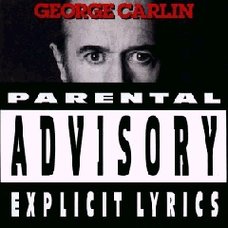
FCC v. Pacifica Foundation (1978)
George Carlin, comedian
Offered a routine called ‘Filthy Words’
Played in the afternoon on WBAI, a New York radio station
Father complained that his son heard broadcast after he came home from school.

Slide 3
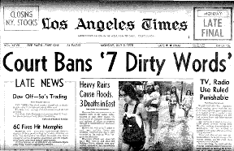
FCC’s power to define and control ‘indecency’
Landmark 5-4 Supreme Court ruling
‘Indecent’ but not obscene. FCC can still control indecency, because of compelling government interest in shielding the most vulnerable in our society.
People should be able to control ‘unwanted’ speech in their own homes

Slide 4
The majority rule
‘Of all forms of communication, broadcasting has the most limited First Amendment protection. Among the reasons for specially treating indecent broadcasting is the uniquely pervasive presence that medium of expression occupies in the lives of our people. Broadcasts extend into the privacy of the home and it is impossible completely to avoid [438 U.S. 726, 728] those that are patently offensive. Broadcasting, moreover, is uniquely accessible to children.’
—Justice John Stevens

Slide 5
The dissent
‘Although an individual's decision to allow public radio communications into his home undoubtedly does not abrogate all of his privacy interests, the residual privacy interests he retains vis-a-vis the communication he voluntarily admits into his home are surely no greater than those of the people present in the corridor of the Los Angeles courthouse in Cohen who bore witness to the words "Fuck the Draft" emblazoned across Cohen's jacket. Their privacy interests were held insufficient to justify punishing Cohen for his offensive communication.’
—Justice W. Brennen

