Slide 1
Defamation, Newsgathering & Privilege
Strange bedfellows…

Slide 2
Wrapping up libel with Hustler v. Falwell (1988)
Hustler Magazine—well known for especially explicit erotica.
Jerry Falwell—well known televangelist, conservative Christian right.
Printed a series of ads that looked like real articles about “first times”
Ad lampooned Jerry Falwell as having lost his virginity to his mother in an outhouse while drinking Campari.

Slide 3
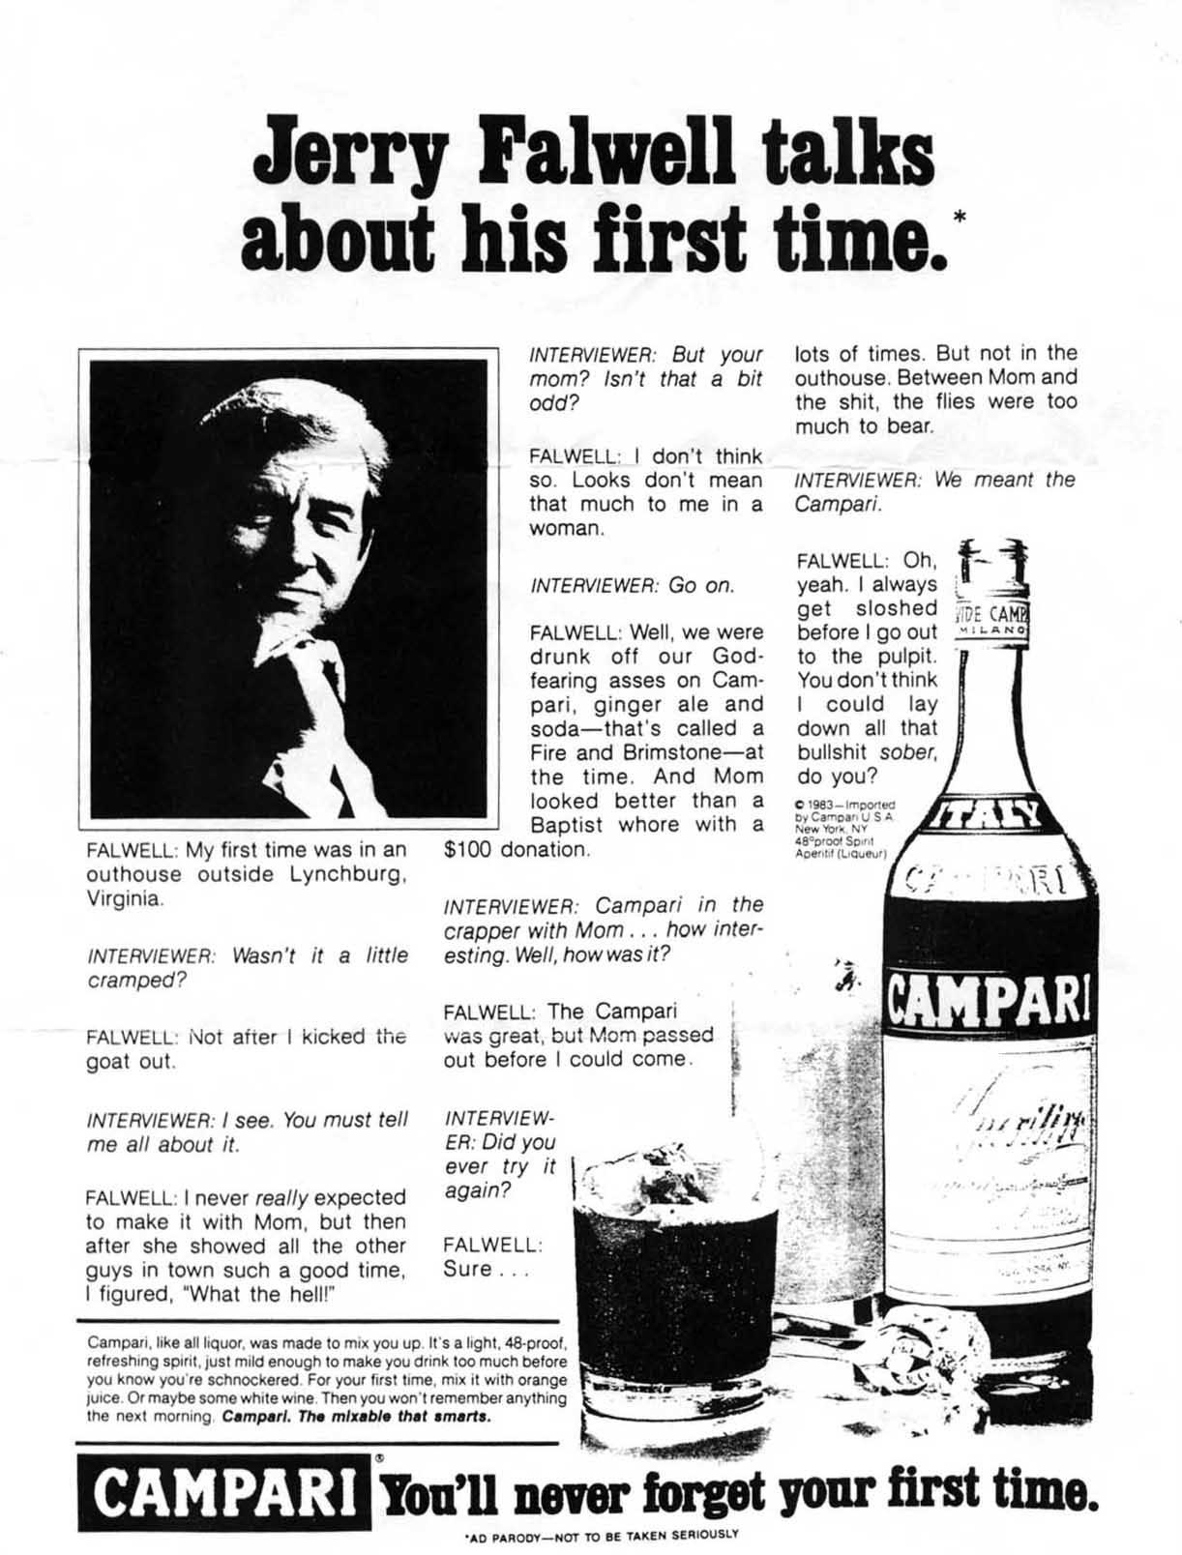

Slide 4
Hustler Magazine, Inc. v. Falwell (1988)
Falwell sued for libel, invasion of privacy
Court believed Falwell was a ‘public figure;’ hence, privacy was not something he could expect
More important: the Court ruled that the ad offered a disclaimer ("ad parody—not to be taken seriously.”)
No reasonable reader would deem it to be anything other than parody—protected by 1A

Slide 5
When journalists become participants instead of observers of the legal system
What ideal would you be willing to go to jail for?
Some journalists have answered, “the protection of my sources.”
Why is there a need to “protect?”
Sometimes there’s an inherent conflict between the goals of the justice system and the goals of journalism.

Slide 6
The need for information v. the need to inform
The goal of the justice system: to prosecute those who violate the letter of the law.
The goal of journalists: to advance community with information—especially when the law is violated.
How can these conflict?
Courts demand information, but journalists cannot/ will not comply

Slide 7
What’s at stake for journalists?
Safety of informants—professional/actual
Personal reputation
Reputation of field
Sources may choose not to trust and therefore vital information may never get out.
Food safety, business ethics violations, Catholic Church sex scandal…all major stories that began with anonymous sources

Slide 8
Reporters’ privilege: A First Amendment guarantee?
Other professions have legal guarantees that protect confidentiality: doctor-patient; lawyer-client.
Why those professions?
No Federal Shield Law for journalists, though some states offer good protection.
Supreme Court has sometimes seen the 1st as protection enough

Slide 9
Shield Laws
Guarantees a news organization/reporter the right to refuse to testify and disclose information or sources in state court.
Why? Because news gatherers cannot do their jobs without the ability to shield informants from prosecution
No federal shield law
Iowa—no state shield law, but ‘qualified privilege.’

Slide 10
Garland v. Torre (1958)
Libel case
Columnist Marie Torre reported that an unnamed CBS official claimed that Garland was balking on doing a planned CBS special because she believed she was “terribly fat.”
Torre refused to name her source and she was cited with contempt.
Court found that it was important to Garland’s case to have the name, so upheld the contempt citation.

Slide 11
Branzburg v. Hayes (1972)
Supreme Court heard three contempt cases together (Branzburg v. Hayes; U.S. v. Caldwell; In re Pappas)
Branzburg was a reporter who had witnessed people handling, making, and using hashish
He reported on it and used anonymous sources.
Because the action was illegal, cops wanted the source names.

Slide 12
Branzburg v. Hayes (1972)
Branzburg lost the case 5-4
Ruled that a reporter cannot avoid testifying
Justice Lewis Powell left open the possibility that the 1st Amendment might excuse a reporter from revealing a source
“Balance” b/w freedom of press and obligation to serve justice necessary

Slide 13
A vision for journalists’ “qualified privilege”
Probable cause—must be pretty clear that the journalist actually has relevant information regarding a violation of the law
Information cannot be obtained by court any other way
Compelling and overriding interest in the information

Slide 14
The 2000s: a tough decade for reporter privilege
A conservative Court less likely to see reporter privilege as more important than other court concerns.
Key cases: Jim Taricani criminal contempt case; New York Times/Judith Miller; Time Magazine/Matthew Cooper; Wen Ho Lee v. Dept. of Justice

Slide 15
Jim Taricani criminal contempt case
WJAR-TV political reporter (Emmy winner)
Taricani was given a videotape of an undercover FBI investigation of alleged corruption of city officials
Taricani refused to provide the name of the source who leaked the tape.
Court found him guilty of criminal contempt—ordered him to house arrest and $1000/day fine
WJAR paid fine ($85,000)

Slide 16
Valerie Plame’s “Outing”
Plame was an undercover CIA operative
Robert Novak, syndicated conservative columnist identified and named her.
Speculation that someone in the Bush administration had purposefully leaked her name to get back at her husband, a diplomat, who contradicted Bush’s claim that Iraq was seeking materials for nuclear weapons in Africa.

Slide 17
Who was the leak?
Justice Dept. sought “leak” because it could be seen as a violation of national security.
Both Judith Miller and Matthew Cooper separately gathered information about the Plame leak.
Both were subpeonaed for their notes and were cited for contempt when they refused.

Slide 18
How the news gatherers responded
New York Times backed Miller, but she went to jail for refusing to comply. She remained in jail until she agreed to testify before a grand jury. She claimed her source had released her from the confidentiality guarantee.
She named I. Lewis “Scooter” Libby, who was eventually indicted and went to jail
Miller later resigned from the NYTimes because her dealings with the White House and Libby were “irregular” and the scrutiny of the case had compromised her professional integrity.

Slide 19
How the news gatherers responded
“In accordance with its duties under the law,” Time magazine chose to turn over Cooper’s notes to the grand jury.
The belief was that this would preclude having Cooper testify. It didn’t. Cooper testified, and after he received a waiver from his source, he named Karl Rove as his source.
Time caught some negative kickback on the compliance from the press, but handled it with public justification.

Slide 20
At Issue: Shield Laws
Currently, no federal shield law, though a Senate shield bill was passed by judiciary committee in December 2009; and the Free Flow of Information Act was passed by the House in March 2009
Currently efforts at protection for journalists reside totally in state shield laws
How do we define ‘journalist? Can a blogger be considered press?

