Slide 1
Keep your hands off my…
Copyright, Trademark and Intellectual Property Issues

Slide 2

Hey, that’s mine!
What is it?
Copyright guarantees specific ownership rights
Exclusive right to reproduce
Create derivative works
Distribute, perform or display the work

Slide 3

What can be copyrighted?
Literary works
Musical works
Dramatic works
Art works (choreographed, pictorial, graphic)
Computer software
Maps
Architectural designs
AND….

Slide 4
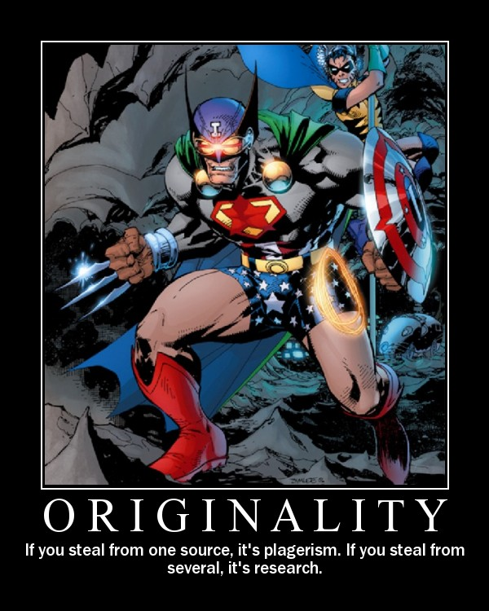
What can be copyrighted?
…and yes, there’s more…
Recordings (interviews, music, speeches, etc.)
Motion picture
Radio or television productions
Just about anything that can be printed or produced for mass consumption

Slide 5

Can news be copyrighted?
News itself—the event—cannot be copyrighted. If it happens, it’s public and fair game for reproduction
BUT a news account CAN and usually IS copyrighted

Slide 6
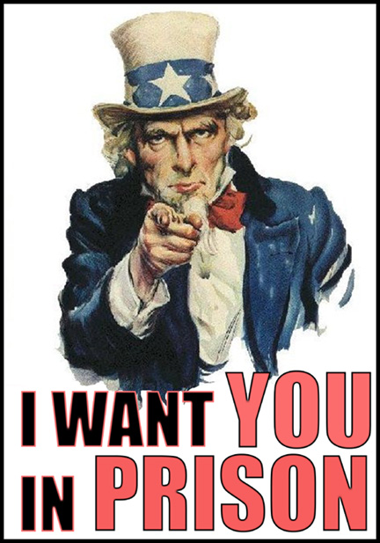
Unfair competition
Re-writing others’ work (a common practice) runs some risk of copyright infringement
Associated Press has strict guidelines and those stories may not even be re-written

Slide 7

How to get a copyright
Apply or register the copyright
Small fee, copy of your work and when and where it was produced.
Can also mail it to yourself and keep it in a sealed envelope

Slide 8
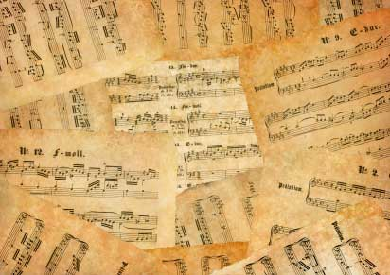
Proving an infringement
(1) ownership of a valid copyright;
(2) factual copying; and
(3) Substantial similarity

Slide 9

Fair Use—How do I get away with using all these images?
Fair Use-- allows limited use of copyrighted material without requiring permission from the rights holders, such as for commentary, criticism, news reporting, research, teaching or scholarship

Slide 10
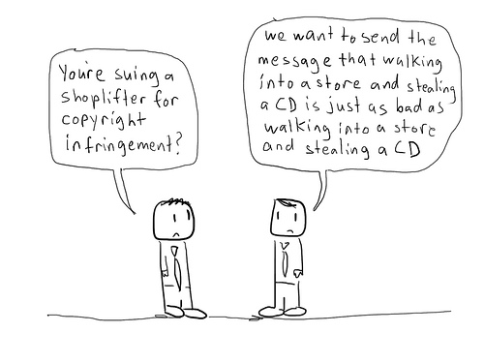
Parodies
If you can prove that the use of the material was for the purpose of parody, that can be an exemption, too.
For example, if we took a famous poem and re-wrote it for the purposes of making fun

Slide 11
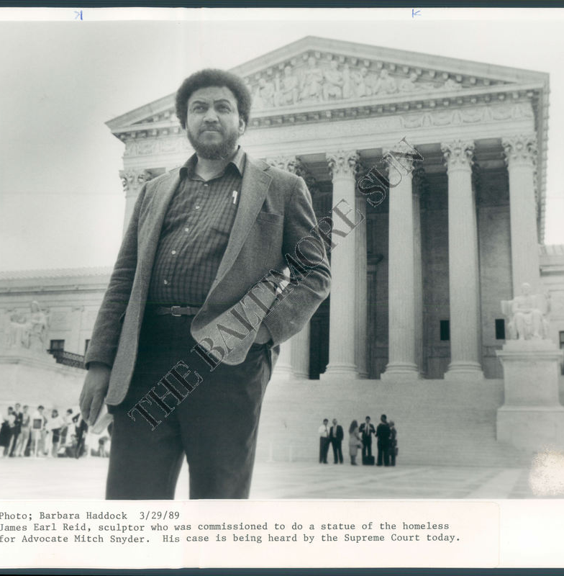
Community for Creative
Non-Violence v. Reid (1989)
CCNV commissioned James Earl Reid to produce a sculpture depicting the plight of the homeless.
No negotiation of copyright in contract
CCNV later claimed to own the rights to the design

Slide 12
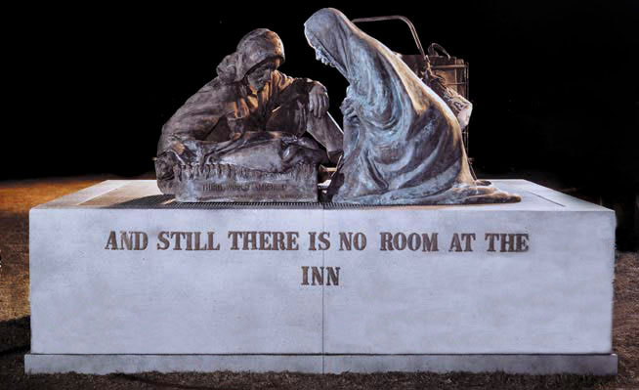
Work-for-hire
The Work-for-hire designation— a piece that is created by an employee as part of his/her regular work duties OR for a client via an agreed-upon set of terms
Under WFH, the owner of the work is generally the employer, not the creator

Slide 13
CCNV v. Reid (1989)
The Court ruled unanimously (9-0)
Held that the artist who creates a commissioned work is considered an ‘independent contractor,’ and is not relegated to the work-for-hire role. Thus, the creator retains copyright.
Thurgood Marshall for the majority: the role of the artist can be modified by contract, so copyright is not always secure for the artist under this ruling.

