Slide 1
Libel, Slander and issues of Ethics
Why the First Amendment Can’t Protect You
if You Defame Another

Slide 2
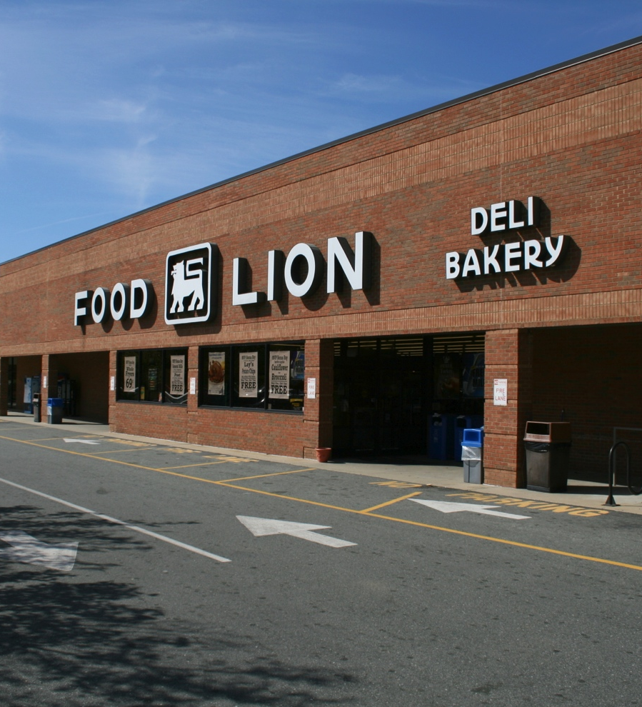
Journalists and Undercover work
ABC Primetime Live sent two staff members in to the Food Lion in undercover (they applied for and got jobs at the store) to report on the unsanitary conditions particularly in the meat department.
ABC found and aired evidence of many health code violations
Food Lion sued—not for libel, but for trespass and fraud.
Court originally found ABC guilty of fraud and trespass and fined it $5.5 million. Later reduced significantly ($315,000 and 4th Circuit Court of Appeals reduced to $2)

Slide 3
Law and Ethics Questions
Food Lion specifically avoided the libel lawsuit in favor of fraud. Why?
The Poynter Institute asked: Is it ever justifiable for a journalist to violate the principle of honesty to honor the principle upon which journalism is founded, a duty to provide the public with meaningful, accurate and comprehensive information about significant issues?

